Slide 1
Encoding Techniques
Encoding data means converting categorical data into numerical data.

Slide 2
Types of Encoding Techniques
Label Encoding
Feature Mapping
One Hot Encoding
Binary Encoding
BaseN Encoding
Target Encoding

Slide 3
Label Encoding
Each category is assigned a value 1 through N
where N is the number of categories in the column.
State | Label Encoding
Goa | 1
Gujarat | 2
Punjab | 3

Slide 4
Feature Mapping
A feature mapping is a function which maps a data vector to a feature space.
It is used in the case of ordinal variables.
Size | Feature Encoding
Low | 1
High | 3
Medium | 2

Slide 5
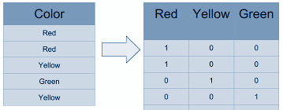
One Hot Encoding
We map each category to a vector that contains 1 or 0.The number of vectors depend on the number of categories.

Slide 6
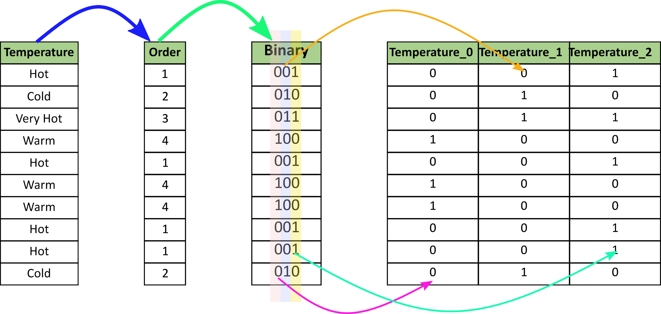
Binary Encoding
It converts a category into binary digits. Each binary digit creates one feature column.

Slide 7
BaseN Encoding
Generalising the value of N in log base N, we get BaseN Encoding.
When our Base is 1, It is One Hot Encoding.
When the Base is 2, It is Binary Encoding, and
If we want a Higher Base, we can use BaseN Encoding, which can be used for Columns where we have huge number of distinct Values.

Slide 8
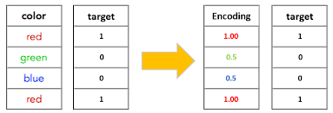
Target Encoding
Process of replacing a categorical value with any of the aggregation of the target variable.

